Slide 1

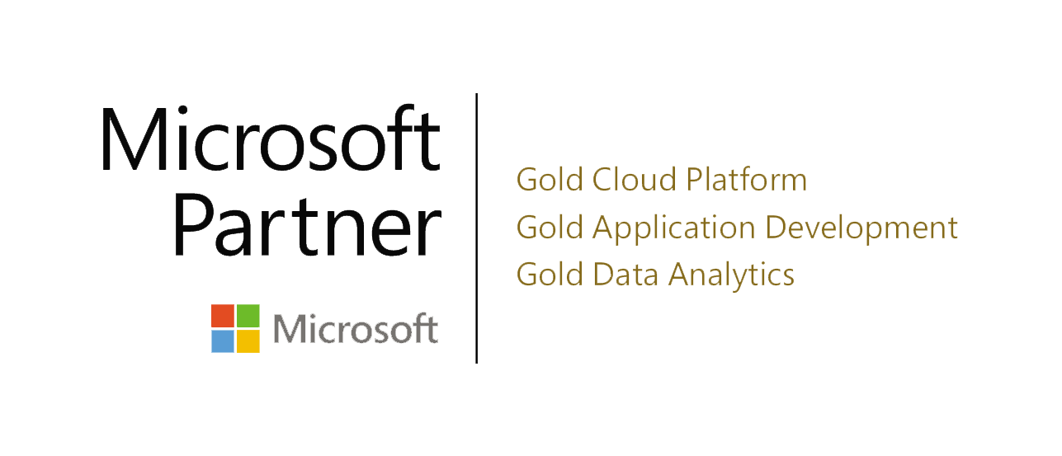

Slide 2

AGENDA
Lixar Intro
Review Cosmos DB
Resource Hierarchy
LAB - Querying Cosmos DB
Request Units
Partitioning
Modeling and Planning
LAB - Change Feed
LAB -Spark Connector
Troubleshooting
Security and GDPR
Wrap Up

Slide 3
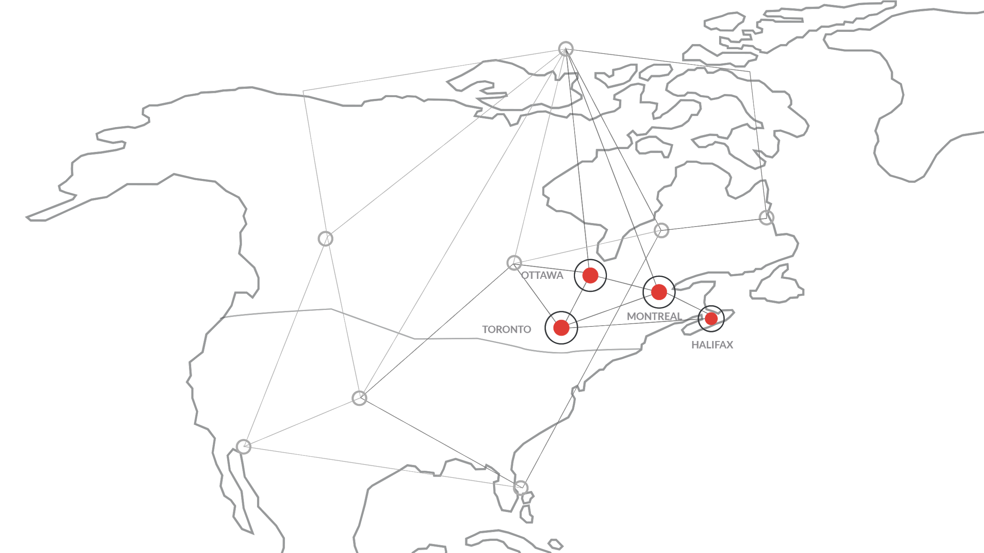
LIXAR Top end-to-end Azure and AI partner in Canada
Founded in 1999
200+ Employees
Creative & Innovative Company Culture
Over 25 Different Nationalities Employed
Official Technology Partner:
Allegiant Air, NASCAR, Bell,
Microsoft, Osheaga
Headquarters
Ottawa, ON
Offices
Halifax, NS
Toronto, ON
Montreal,QC

Slide 4

















LIXAR INDUSTRY FOCUS
AIR
AUTO
TELCO
SPORTS & ENTERTAINMENT
GOVERNMENT

Slide 5





LIXAR TECH PILLARS
DATA CONVERGENCE
MOBILE
INTERNET OF THINGS
CLOUD SOLUTIONS
| Data Advisory
| Data Engineering
| Data Science
| Data Visualization
| iOS / Android / Wearable
| Contextual Audio SDK
| AI Recommendation Engines
| Proximity Awareness SDK
| 5G
| Sensors
| Connected Cars
| Making physical things smart
| Scalability
| Architecture
| Microsoft Azure
| Digital Transformation Advisory
Notes:
We feel like we are well aligned with Microsoft Investments.

Slide 6





At LIXAR YOU’RE HIRING A TEAM
ADVISORY
ENGINEERING
SCIENCE & A.I.
VISUALIZATION
| Building a Data Strategy
| Regulation & Compliance
| Technical Workshops
| Modernizing BI
| Data Lakes
| Governance & Lineage
| Real-Time Pipelines
| Cloud Architecture
| Prediction & Forecasting
| Simulation
| Recommendation Engines
| NLP & Semantic Analysis
| Interactive Reporting
| Self-Service BI
| Real-Time Dashboards
| User Experience
Notes:
We feel like we are well aligned with Microsoft Investments.
The data practice is not about assigning a person to a project, its about leveraging a team and its knowledge to advise on their data strategy, build the new back end, the visualize the sotries and the insights and ultimately get them to the predictive state.

Slide 7
AGENDA
Lixar Intro
Review Cosmos DB
Resource Hierarchy
LAB - Querying Cosmos DB
Request Units
Partitioning
Modeling and Planning
LAB - Change Feed
LAB -Spark Connector
Troubleshooting
Security and GDPR
Wrap Up

Slide 8
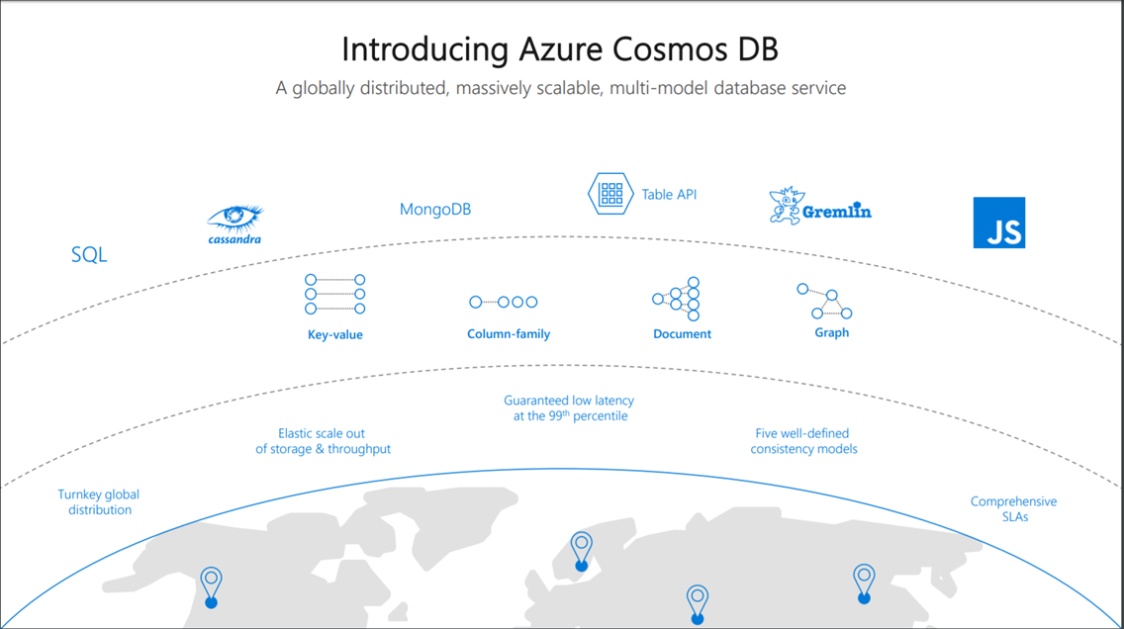

Cosmos DB Overview
| Globally Distributed
| Massively Scalable
| Multi-model database service
Notes:
Data Strategy
Understanding the data ecosystem
Inventory of datasets including their purpose
Understanding the pain points
Make recommendations and sell a vision
Propose POCs, MVPs and Full Roadmap as a packaged deliverable
Huge opportunity to learn about a potential customer
Deliverable that clearly defines next steps
Clear roadmap with a general idea of TCO

Slide 9
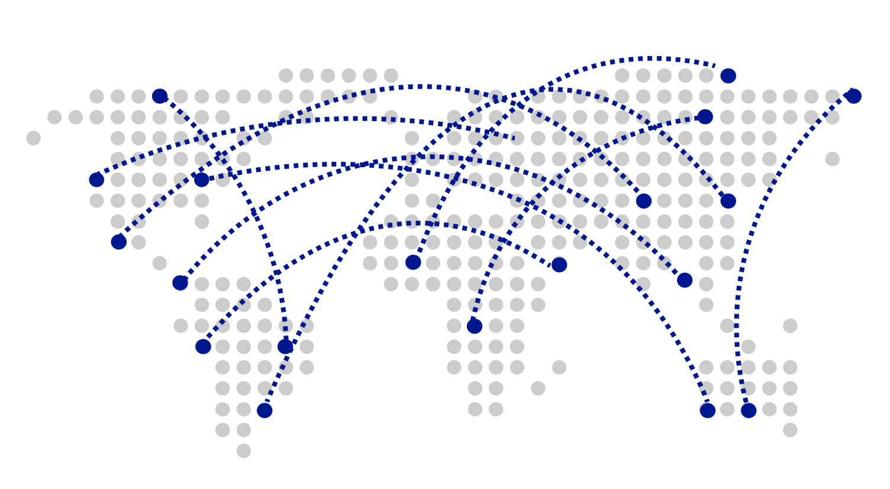
Turnkey Global Distribution
Worldwide presence as a Foundational Azure service
Automatic multi-region replication
Multi-homing APIs
Manual and automatic failovers
Designed for High Availability
Large scale database backed by HDFS
Notes:
Data Strategy
Understanding the data ecosystem
Inventory of datasets including their purpose
Understanding the pain points
Make recommendations and sell a vision
Propose POCs, MVPs and Full Roadmap as a packaged deliverable
Huge opportunity to learn about a potential customer
Deliverable that clearly defines next steps
Clear roadmap with a general idea of TCO

Slide 10

Guaranteed low latency at P99 (99th percentile)
Requests are served from local region
Single-digit millisecond latency worldwide
Write optimized, latch-free database engine designed for SSD
Synchronous automatic indexing at sustained ingestion rates
Notes:
Data Strategy
Understanding the data ecosystem
Inventory of datasets including their purpose
Understanding the pain points
Make recommendations and sell a vision
Propose POCs, MVPs and Full Roadmap as a packaged deliverable
Huge opportunity to learn about a potential customer
Deliverable that clearly defines next steps
Clear roadmap with a general idea of TCO

Slide 11
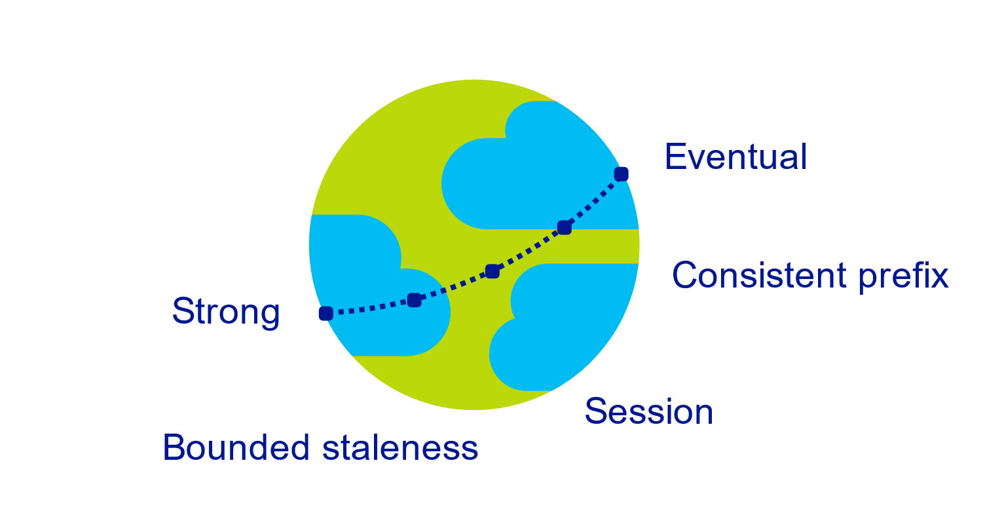
Multiple, well-defined consistency choices
Global distribution forces us to navigate the CAP theorem
Writing correct distributed applications is hard
Five well-defined consistency levels
Intuitive and practical with clear PACELC tradeoffs
Programmatically change at anytime
Can be overridden on a per-request basis
Notes:
Data Strategy
Understanding the data ecosystem
Inventory of datasets including their purpose
Understanding the pain points
Make recommendations and sell a vision
Propose POCs, MVPs and Full Roadmap as a packaged deliverable
Huge opportunity to learn about a potential customer
Deliverable that clearly defines next steps
Clear roadmap with a general idea of TCO

Slide 12

Elastically scalable storage and throughput
Single machine is never a bottle neck
Transparent server-side partition management
Elastically scale storage (GB to PB) and throughput (100 to 100M req/sec) across many machines and multiple regions
Automatic expiration via policy based TTL
Pay by the hour, change throughput at any time for only what you need
Notes:
Data Strategy
Understanding the data ecosystem
Inventory of datasets including their purpose
Understanding the pain points
Make recommendations and sell a vision
Propose POCs, MVPs and Full Roadmap as a packaged deliverable
Huge opportunity to learn about a potential customer
Deliverable that clearly defines next steps
Clear roadmap with a general idea of TCO

Slide 13
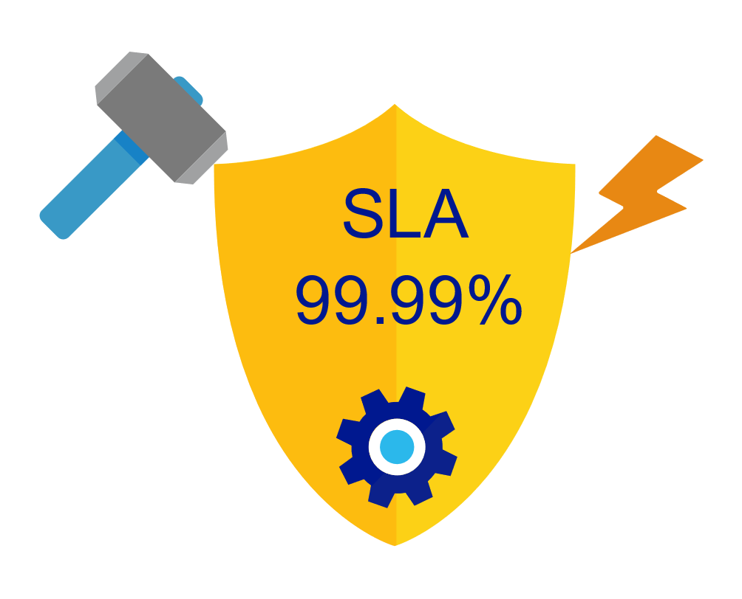
Elastically scalable storage and throughput
99.99% availability – even with a single region
Made possible with highly-redundant storage architecture
Guaranteed durability – writes are majority quorum committed
First and only service to offer SLAs on:
Low-latency
Consistency
Throughput
Notes:
Data Strategy
Understanding the data ecosystem
Inventory of datasets including their purpose
Understanding the pain points
Make recommendations and sell a vision
Propose POCs, MVPs and Full Roadmap as a packaged deliverable
Huge opportunity to learn about a potential customer
Deliverable that clearly defines next steps
Clear roadmap with a general idea of TCO

Slide 14
Schema-agnostic, automatic indexing
At global scale, schema/index management is painful
Automatic and synchronous indexing
Hash, range, and geospatial
Works across every data model
Highly write-optimized database engine
Schema
Physical index
Notes:
Inverted Tree???

Slide 15
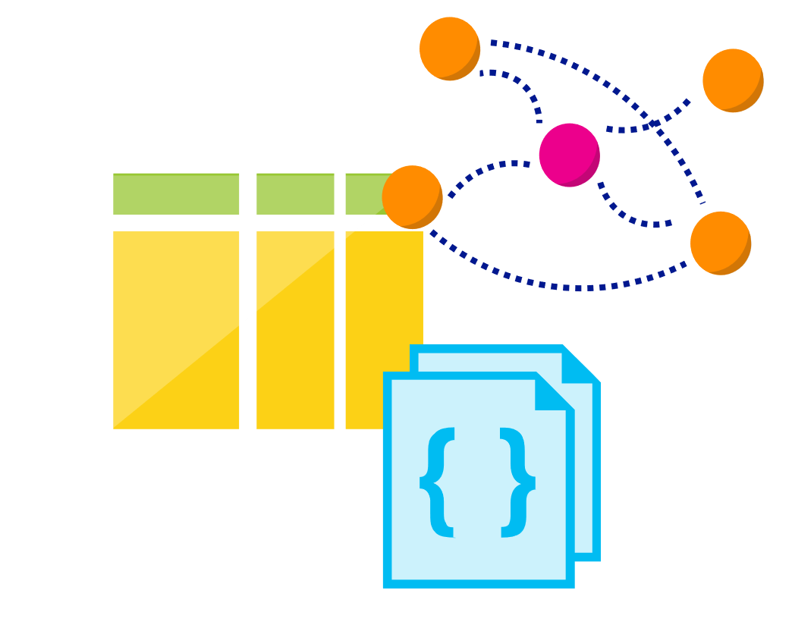
Multi-model, multi-API
Database engine operates on Atom-Record-Sequence type system
All data models can be efficiently translated to ARS
Multi-model: Key-value, Document, Column, and Graph
Multi-API: SQL (DocumentDB), MongoDB, Table, Cassandra and Gremlin
More data-models and APIs to be added
Notes:
Data Strategy
Understanding the data ecosystem
Inventory of datasets including their purpose
Understanding the pain points
Make recommendations and sell a vision
Propose POCs, MVPs and Full Roadmap as a packaged deliverable
Huge opportunity to learn about a potential customer
Deliverable that clearly defines next steps
Clear roadmap with a general idea of TCO

Slide 16
AGENDA
Lixar Intro
Review Cosmos DB
Resource Hierarchy
LAB - Querying Cosmos DB
Request Units
Partitioning
Modeling and Planning
LAB - Change Feed
LAB -Spark Connector
Troubleshooting
Security and GDPR
Wrap Up

Slide 17
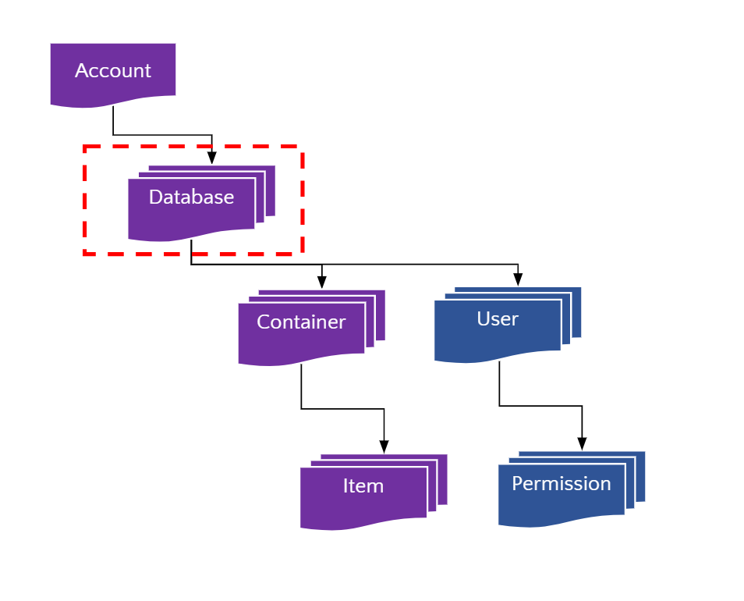
Resource Hierarchy
| Globally Distributed
| Massively Scalable
| Multi-model database service
Notes:
Data Strategy
Understanding the data ecosystem
Inventory of datasets including their purpose
Understanding the pain points
Make recommendations and sell a vision
Propose POCs, MVPs and Full Roadmap as a packaged deliverable
Huge opportunity to learn about a potential customer
Deliverable that clearly defines next steps
Clear roadmap with a general idea of TCO

Slide 18
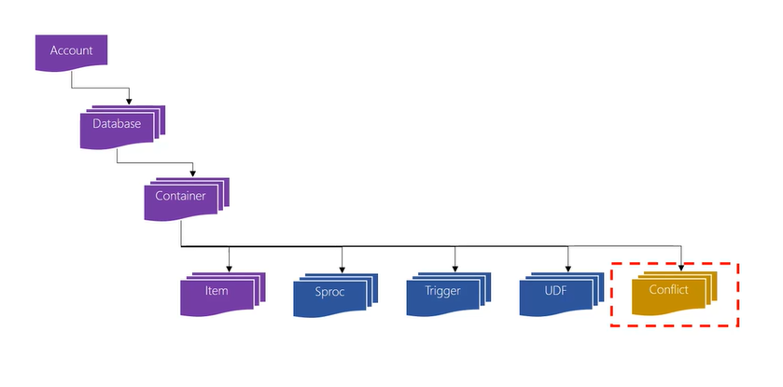
Resource Hierarchy
| Globally Distributed
| Massively Scalable
| Multi-model database service
Notes:
Data Strategy
Understanding the data ecosystem
Inventory of datasets including their purpose
Understanding the pain points
Make recommendations and sell a vision
Propose POCs, MVPs and Full Roadmap as a packaged deliverable
Huge opportunity to learn about a potential customer
Deliverable that clearly defines next steps
Clear roadmap with a general idea of TCO

Slide 19
AGENDA
Lixar Intro
Review Cosmos DB
Resource Hierarchy
LAB - Querying Cosmos DB
Request Units
Partitioning
Modeling and Planning
LAB - Change Feed
LAB -Spark Connector
Troubleshooting
Security and GDPR
Wrap Up

Slide 20


LAB 1 - Querying Cosmo DB
Cosmos DB Resource Creation through Azure CLI
Create twitter messages and upload to Cosmos DB
Update / Replace tweet documents
Upsert Tweet document
Delete Tweet document
Write SQL query to retrieve Tweet by Tweet Id
Advanced SQL query (JOIN) to search Tweets based on HashTag
https://github.com/cosmoshackathon/CosmosDBHandsonLab
Notes:
Data Strategy
Understanding the data ecosystem
Inventory of datasets including their purpose
Understanding the pain points
Make recommendations and sell a vision
Propose POCs, MVPs and Full Roadmap as a packaged deliverable
Huge opportunity to learn about a potential customer
Deliverable that clearly defines next steps
Clear roadmap with a general idea of TCO

Slide 21
LAB 1 - Querying Cosmo DB
Cosmos DB Resource Creation through Azure CLI
Create twitter messages and upload to Cosmos DB
Update / Replace tweet documents
Upsert Tweet document
Delete Tweet document
Write SQL query to retrieve Tweet by Tweet Id
Advanced SQL query (JOIN) to search Tweets based on HashTag
https://github.com/cosmoshackathon/CosmosDBHandsonLab
Notes:
Data Strategy
Understanding the data ecosystem
Inventory of datasets including their purpose
Understanding the pain points
Make recommendations and sell a vision
Propose POCs, MVPs and Full Roadmap as a packaged deliverable
Huge opportunity to learn about a potential customer
Deliverable that clearly defines next steps
Clear roadmap with a general idea of TCO

Slide 22
LAB 1 - Querying Cosmo DB
Cosmos DB Resource Creation through Azure CLI
Create twitter messages and upload to Cosmos DB
Update / Replace tweet documents
Upsert Tweet document
Delete Tweet document
Write SQL query to retrieve Tweet by Tweet Id
Advanced SQL query (JOIN) to search Tweets based on HashTag
https://github.com/cosmoshackathon/CosmosDBHandsonLab
Notes:
Data Strategy
Understanding the data ecosystem
Inventory of datasets including their purpose
Understanding the pain points
Make recommendations and sell a vision
Propose POCs, MVPs and Full Roadmap as a packaged deliverable
Huge opportunity to learn about a potential customer
Deliverable that clearly defines next steps
Clear roadmap with a general idea of TCO

Slide 23
LAB 1 - Querying Cosmo DB
Cosmos DB Resource Creation through Azure CLI
Create twitter messages and upload to Cosmos DB
Update / Replace tweet documents
Upsert Tweet document
Delete Tweet document
Write SQL query to retrieve Tweet by Tweet Id
Advanced SQL query (JOIN) to search Tweets based on HashTag
https://github.com/cosmoshackathon/CosmosDBHandsonLab
Notes:
Data Strategy
Understanding the data ecosystem
Inventory of datasets including their purpose
Understanding the pain points
Make recommendations and sell a vision
Propose POCs, MVPs and Full Roadmap as a packaged deliverable
Huge opportunity to learn about a potential customer
Deliverable that clearly defines next steps
Clear roadmap with a general idea of TCO

Slide 24
LAB 1 - Querying Cosmo DB
Cosmos DB Resource Creation through Azure CLI
Create twitter messages and upload to Cosmos DB
Update / Replace tweet documents
Upsert Tweet document
Delete Tweet document
Write SQL query to retrieve Tweet by Tweet Id
Advanced SQL query (JOIN) to search Tweets based on HashTag
https://github.com/cosmoshackathon/CosmosDBHandsonLab
Notes:
Data Strategy
Understanding the data ecosystem
Inventory of datasets including their purpose
Understanding the pain points
Make recommendations and sell a vision
Propose POCs, MVPs and Full Roadmap as a packaged deliverable
Huge opportunity to learn about a potential customer
Deliverable that clearly defines next steps
Clear roadmap with a general idea of TCO

Slide 25
LAB 1 - Querying Cosmo DB
Cosmos DB Resource Creation through Azure CLI
Create twitter messages and upload to Cosmos DB
Update / Replace tweet documents
Upsert Tweet document
Delete Tweet document
Write SQL query to retrieve Tweet by Tweet Id
Advanced SQL query (JOIN) to search Tweets based on HashTag
https://github.com/cosmoshackathon/CosmosDBHandsonLab
Notes:
Data Strategy
Understanding the data ecosystem
Inventory of datasets including their purpose
Understanding the pain points
Make recommendations and sell a vision
Propose POCs, MVPs and Full Roadmap as a packaged deliverable
Huge opportunity to learn about a potential customer
Deliverable that clearly defines next steps
Clear roadmap with a general idea of TCO

Slide 26
LAB 1 - Querying Cosmo DB
Cosmos DB Resource Creation through Azure CLI
Create twitter messages and upload to Cosmos DB
Update / Replace tweet documents
Upsert Tweet document
Delete Tweet document
Write SQL query to retrieve Tweet by Tweet Id
Advanced SQL query (JOIN) to search Tweets based on HashTag
https://github.com/cosmoshackathon/CosmosDBHandsonLab
Notes:
Data Strategy
Understanding the data ecosystem
Inventory of datasets including their purpose
Understanding the pain points
Make recommendations and sell a vision
Propose POCs, MVPs and Full Roadmap as a packaged deliverable
Huge opportunity to learn about a potential customer
Deliverable that clearly defines next steps
Clear roadmap with a general idea of TCO

Slide 27
AGENDA
Lixar Intro
Review Cosmos DB
Resource Hierarchy
LAB - Querying Cosmos DB
Request Units
Partitioning
Modeling and Planning
LAB - Change Feed
LAB -Spark Connector
Troubleshooting
Security and GDPR
Wrap Up

Slide 28
Request Units
Request Units (RU) is a rate-based currency
Abstracts physical resources for performing requests
Key to providing isolation in a multi-tenant environment
Enables SLAs for predictable performance
Foreground and background activities
% CPU
% Memory
% IOPS
Notes:
Data Strategy
Understanding the data ecosystem
Inventory of datasets including their purpose
Understanding the pain points
Make recommendations and sell a vision
Propose POCs, MVPs and Full Roadmap as a packaged deliverable
Huge opportunity to learn about a potential customer
Deliverable that clearly defines next steps
Clear roadmap with a general idea of TCO

Slide 29
Request Units
Normalized across various access methods
1 RU = 1 read of 1 KB record
Each request consumes fixed RUs
Applies to reads, writes, queries, and stored procedure execution
GET
POST
PUT
Query
…
Notes:
Data Strategy
Understanding the data ecosystem
Inventory of datasets including their purpose
Understanding the pain points
Make recommendations and sell a vision
Propose POCs, MVPs and Full Roadmap as a packaged deliverable
Huge opportunity to learn about a potential customer
Deliverable that clearly defines next steps
Clear roadmap with a general idea of TCO

Slide 30
Request Units
Provisioned in terms of RU/sec
Rate limiting based on amount of throughput provisioned
Can be increased or decreased instantaneously
Billing is metered hourly
Background processes like TTL expiration, index transformations scheduled when quiescent
Rate limit
Max RU/sec
No throttling
Incoming Requests
Min RU/sec
Replica
Quiescent
Notes:
Data Strategy
Understanding the data ecosystem
Inventory of datasets including their purpose
Understanding the pain points
Make recommendations and sell a vision
Propose POCs, MVPs and Full Roadmap as a packaged deliverable
Huge opportunity to learn about a potential customer
Deliverable that clearly defines next steps
Clear roadmap with a general idea of TCO

Slide 31
AGENDA
Lixar Intro
Review Cosmos DB
Resource Hierarchy
LAB - Querying Cosmos DB
Request Units
Partitioning
Modeling and Planning
LAB - Change Feed
LAB -Spark Connector
Troubleshooting
Security and GDPR
Wrap Up

Slide 32
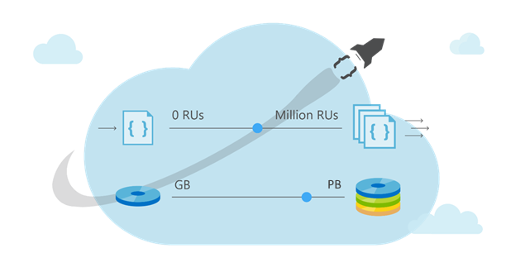
Partitions
| Cosmos DB Container (e.g. Collection)
Notes:
Data Strategy
Understanding the data ecosystem
Inventory of datasets including their purpose
Understanding the pain points
Make recommendations and sell a vision
Propose POCs, MVPs and Full Roadmap as a packaged deliverable
Huge opportunity to learn about a potential customer
Deliverable that clearly defines next steps
Clear roadmap with a general idea of TCO

Slide 33
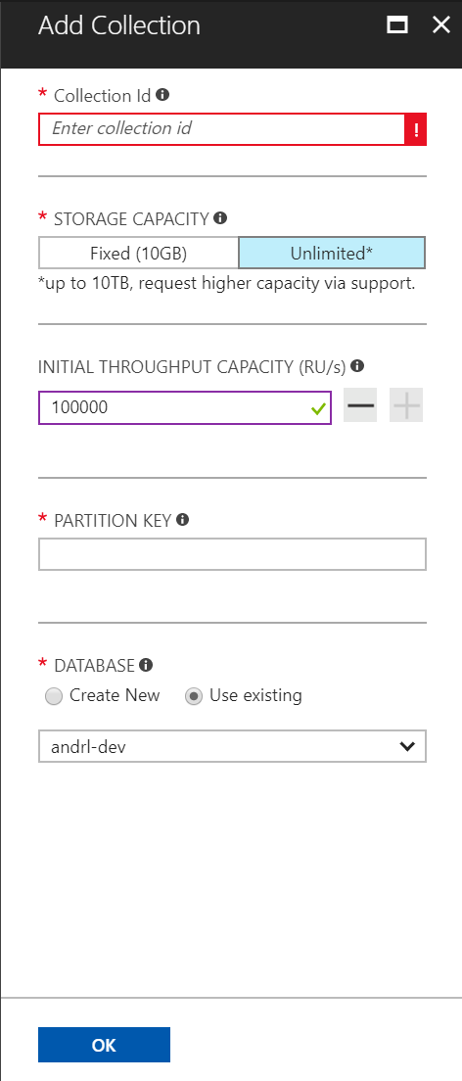
Partitions Scheme - Top Most Design Decision
| Cosmos DB Container (e.g. Collection)
Notes:
Data Strategy
Understanding the data ecosystem
Inventory of datasets including their purpose
Understanding the pain points
Make recommendations and sell a vision
Propose POCs, MVPs and Full Roadmap as a packaged deliverable
Huge opportunity to learn about a potential customer
Deliverable that clearly defines next steps
Clear roadmap with a general idea of TCO

Slide 34
Partitions
Partition Key: User Id
Logical Partitioning Abstraction
hash(User Id)
Behind the Scenes:
Physical Partition Sets
| Cosmos DB Container (e.g. Collection)
Psuedo-random distribution of data over range of possible hashed values
Notes:
Data Strategy
Understanding the data ecosystem
Inventory of datasets including their purpose
Understanding the pain points
Make recommendations and sell a vision
Propose POCs, MVPs and Full Roadmap as a packaged deliverable
Huge opportunity to learn about a potential customer
Deliverable that clearly defines next steps
Clear roadmap with a general idea of TCO

Slide 35
Partitions - Best Practices
Design Goals for Choosing a Good Partition Key
Distribute the overall request and storage volume.
Avoid “hot” partition key values
By default, there can be up to 10 GB of data per partition key value
Partition Key is scope for [efficient] queries and transactions
Queries can be intelligently routed via partition key value.
Omitting partition key on query requires fan-out.
Notes:
Data Strategy
Understanding the data ecosystem
Inventory of datasets including their purpose
Understanding the pain points
Make recommendations and sell a vision
Propose POCs, MVPs and Full Roadmap as a packaged deliverable
Huge opportunity to learn about a potential customer
Deliverable that clearly defines next steps
Clear roadmap with a general idea of TCO

Slide 36
Partitions - Best Practices
Steps for Success
Ballpark scale needs (size/throughput)
Understand the workload
# of reads/sec vs writes per sec
Use 80/20 rule to help optimize bulk of workload
For reads - understand top 3-5 queries(look for common filters)
For writes-understand transactional needs
Notes:
Data Strategy
Understanding the data ecosystem
Inventory of datasets including their purpose
Understanding the pain points
Make recommendations and sell a vision
Propose POCs, MVPs and Full Roadmap as a packaged deliverable
Huge opportunity to learn about a potential customer
Deliverable that clearly defines next steps
Clear roadmap with a general idea of TCO

Slide 37
AGENDA
Lixar Intro
Review Cosmos DB
Resource Hierarchy
LAB - Querying Cosmos DB
Request Units
Partitioning
Modeling and Planning
LAB - Change Feed
LAB -Spark Connector
Troubleshooting
Security and GDPR
Wrap Up

Slide 38
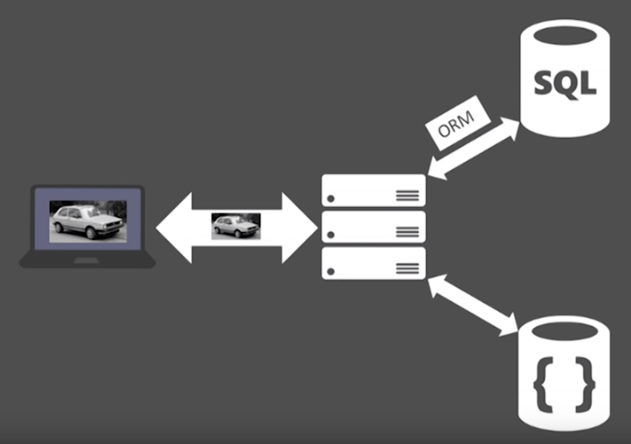
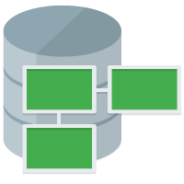
Data Modeling
Notes:
Data Strategy
Understanding the data ecosystem
Inventory of datasets including their purpose
Understanding the pain points
Make recommendations and sell a vision
Propose POCs, MVPs and Full Roadmap as a packaged deliverable
Huge opportunity to learn about a potential customer
Deliverable that clearly defines next steps
Clear roadmap with a general idea of TCO

Slide 39
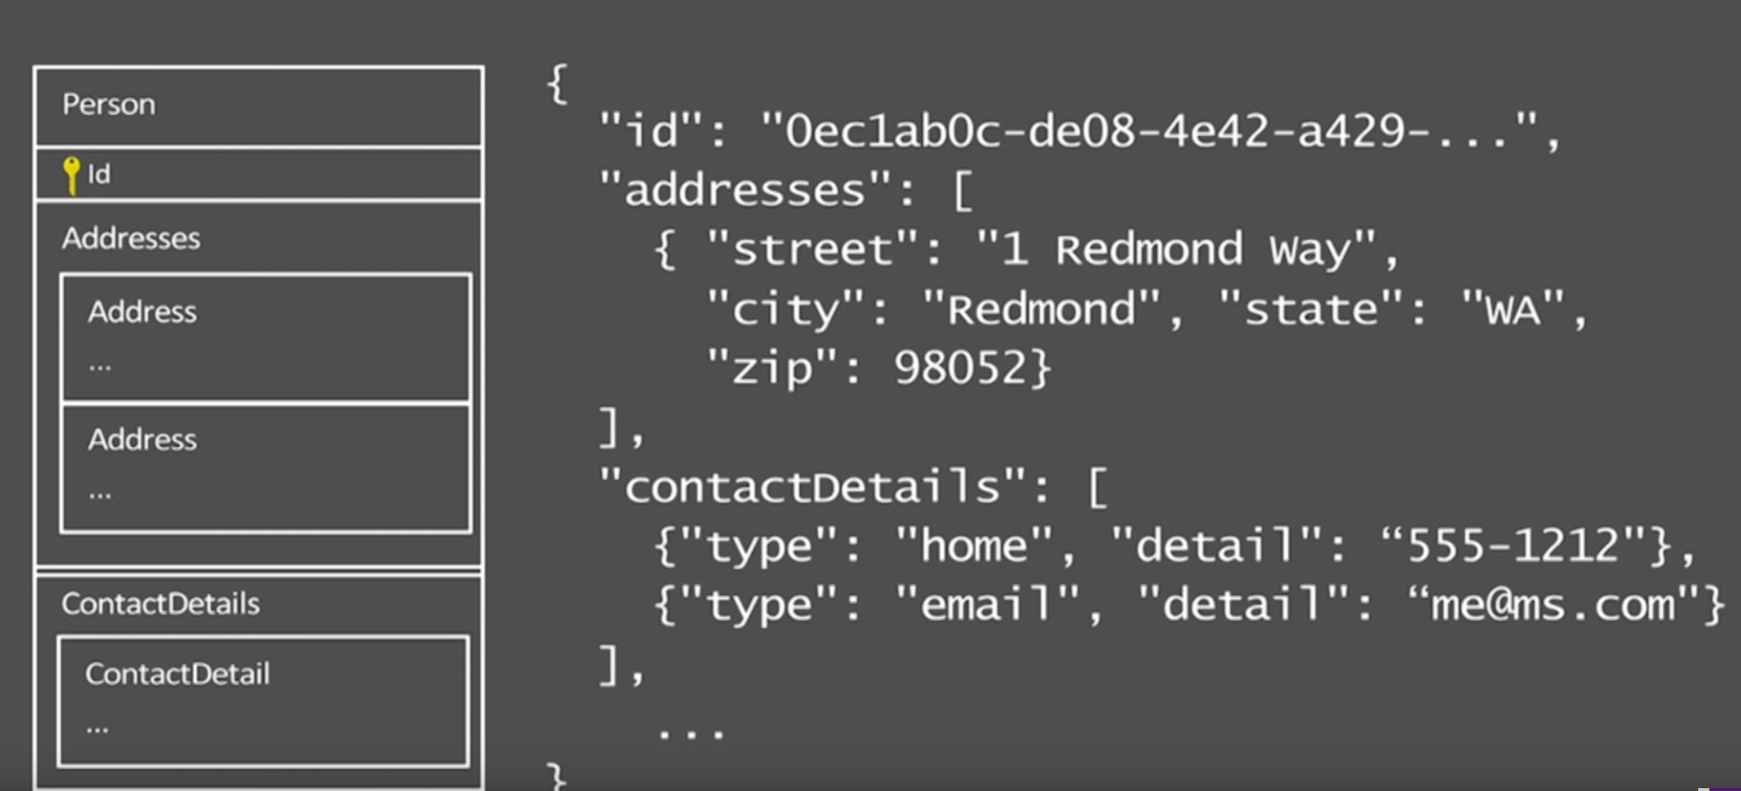
Data Modeling - The document way
Notes:
Data Strategy
Understanding the data ecosystem
Inventory of datasets including their purpose
Understanding the pain points
Make recommendations and sell a vision
Propose POCs, MVPs and Full Roadmap as a packaged deliverable
Huge opportunity to learn about a potential customer
Deliverable that clearly defines next steps
Clear roadmap with a general idea of TCO

Slide 40

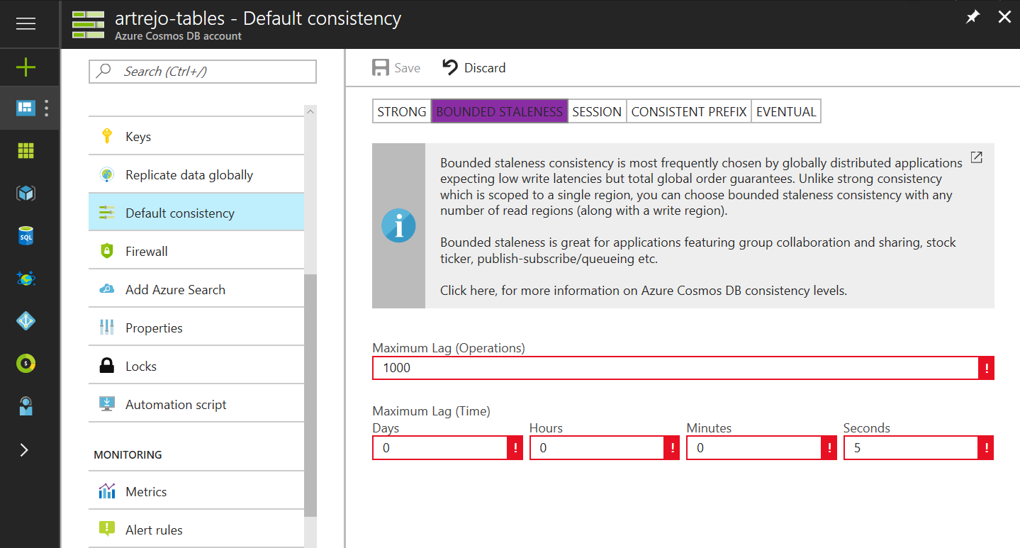
Data Modeling - Well-defined consistency models
Intuitive programming model
5 Well-defined, consistency models
Overridable on a per-request basis
Notes:
Data Strategy
Understanding the data ecosystem
Inventory of datasets including their purpose
Understanding the pain points
Make recommendations and sell a vision
Propose POCs, MVPs and Full Roadmap as a packaged deliverable
Huge opportunity to learn about a potential customer
Deliverable that clearly defines next steps
Clear roadmap with a general idea of TCO

Slide 41

Data Modeling - Well-defined consistency models trade offs
Latency
Availability
Throughput
Notes:
Data Strategy
Understanding the data ecosystem
Inventory of datasets including their purpose
Understanding the pain points
Make recommendations and sell a vision
Propose POCs, MVPs and Full Roadmap as a packaged deliverable
Huge opportunity to learn about a potential customer
Deliverable that clearly defines next steps
Clear roadmap with a general idea of TCO

Slide 42
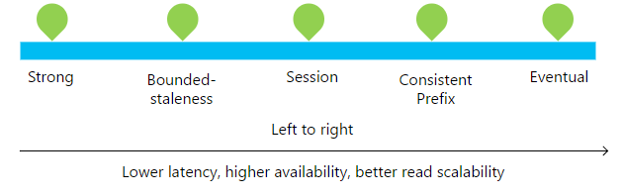
Data Modeling - Consistency Level
Notes:
Data Strategy
Understanding the data ecosystem
Inventory of datasets including their purpose
Understanding the pain points
Make recommendations and sell a vision
Propose POCs, MVPs and Full Roadmap as a packaged deliverable
Huge opportunity to learn about a potential customer
Deliverable that clearly defines next steps
Clear roadmap with a general idea of TCO

Slide 43
Data Modeling - Consistency Level
Consistency Level | Guarantees
Strong | Linearizability (once operation is complete, it will be visible to all)
Bounded Staleness | Consistent Prefix. Reads lag behind writes by at most k prefixes or t interval Similar properties to strong consistency (except within staleness window), while preserving 99.99% availability and low latency.
Session | Consistent Prefix. Within a session: monotonic reads, monotonic writes, read-your-writes, write-follows-reads Predictable consistency for a session, high read throughput + low latency
Consistent Prefix | Reads will never see out of order writes (no gaps).
Eventual | Potential for out of order reads. Lowest cost for reads of all consistency levels.
Notes:
Data Strategy
Understanding the data ecosystem
Inventory of datasets including their purpose
Understanding the pain points
Make recommendations and sell a vision
Propose POCs, MVPs and Full Roadmap as a packaged deliverable
Huge opportunity to learn about a potential customer
Deliverable that clearly defines next steps
Clear roadmap with a general idea of TCO

Slide 44
Data Modeling - Consistency Level
Bounded-Staleness: Bounds are set server-side via the Azure Portal
Notes:
Data Strategy
Understanding the data ecosystem
Inventory of datasets including their purpose
Understanding the pain points
Make recommendations and sell a vision
Propose POCs, MVPs and Full Roadmap as a packaged deliverable
Huge opportunity to learn about a potential customer
Deliverable that clearly defines next steps
Clear roadmap with a general idea of TCO

Slide 45
Data Modeling - Consistency Level
Session Consistency: Session is controlled using a “session token”.
Session tokens are automatically cached by the Client SDK
Can be pulled out and used to override other requests (to preserve session between multiple clients)
string sessionToken;
using (DocumentClient client = new DocumentClient(new Uri(""), ""))
{
ResourceResponse<Document> response = client.CreateDocumentAsync(
collectionLink,
new { id = "an id", value = "some value" }
).Result;
sessionToken = response.SessionToken;
}
using (DocumentClient client = new DocumentClient(new Uri(""), ""))
{
ResourceResponse<Document> read = client.ReadDocumentAsync(
documentLink,
new RequestOptions { SessionToken = sessionToken }
).Result;
}
Notes:
Data Strategy
Understanding the data ecosystem
Inventory of datasets including their purpose
Understanding the pain points
Make recommendations and sell a vision
Propose POCs, MVPs and Full Roadmap as a packaged deliverable
Huge opportunity to learn about a potential customer
Deliverable that clearly defines next steps
Clear roadmap with a general idea of TCO

Slide 46
Data Modeling - Consistency Level
Consistency can be relaxed on a per-request basis
client.ReadDocumentAsync(
documentLink,
new RequestOptions { ConsistencyLevel = ConsistencyLevel.Eventual }
);
Notes:
Data Strategy
Understanding the data ecosystem
Inventory of datasets including their purpose
Understanding the pain points
Make recommendations and sell a vision
Propose POCs, MVPs and Full Roadmap as a packaged deliverable
Huge opportunity to learn about a potential customer
Deliverable that clearly defines next steps
Clear roadmap with a general idea of TCO

Slide 47
AGENDA
Lixar Intro
Review Cosmos DB
Resource Hierarchy
LAB - Querying Cosmos DB
Request Units
Partitioning
Modeling and Planning
LAB - Change Feed
LAB -Spark Connector
Troubleshooting
Security and GDPR
Wrap Up

Slide 48
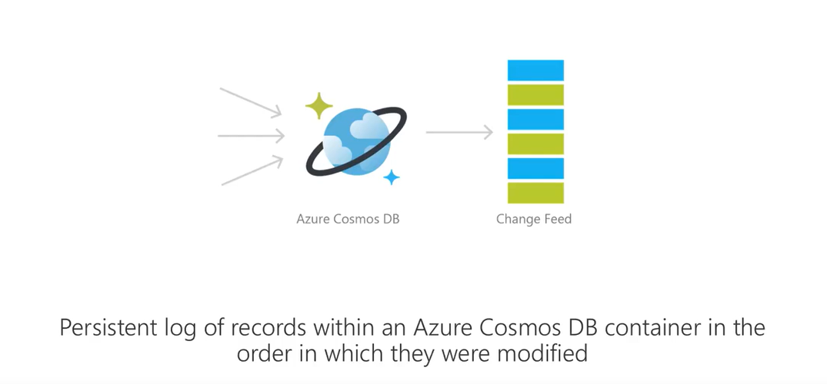
Change Feed
Notes:
Data Strategy
Understanding the data ecosystem
Inventory of datasets including their purpose
Understanding the pain points
Make recommendations and sell a vision
Propose POCs, MVPs and Full Roadmap as a packaged deliverable
Huge opportunity to learn about a potential customer
Deliverable that clearly defines next steps
Clear roadmap with a general idea of TCO

Slide 49


LAB 2 - Change Feed
Create Azure Function app that monitors to Events in Cosmos DB Collection
Create .NET Core app that monitors Events in a Cosmos DB Collection
https://github.com/cosmoshackathon/CosmosDBHandsonLab/tree/master/lab/ChangeFeed/
Notes:
Data Strategy
Understanding the data ecosystem
Inventory of datasets including their purpose
Understanding the pain points
Make recommendations and sell a vision
Propose POCs, MVPs and Full Roadmap as a packaged deliverable
Huge opportunity to learn about a potential customer
Deliverable that clearly defines next steps
Clear roadmap with a general idea of TCO

Slide 50
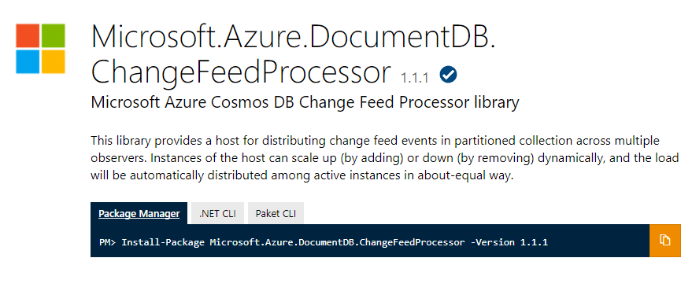
Change Feed Processor Library
Notes:
Data Strategy
Understanding the data ecosystem
Inventory of datasets including their purpose
Understanding the pain points
Make recommendations and sell a vision
Propose POCs, MVPs and Full Roadmap as a packaged deliverable
Huge opportunity to learn about a potential customer
Deliverable that clearly defines next steps
Clear roadmap with a general idea of TCO

Slide 51
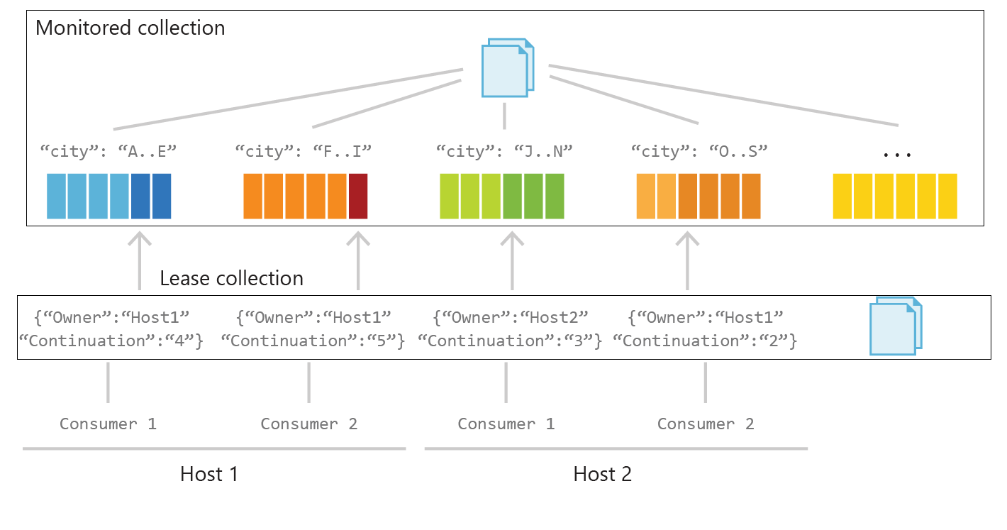
Change Feed Processor Library - Behind the Scenes
Notes:
Data Strategy
Understanding the data ecosystem
Inventory of datasets including their purpose
Understanding the pain points
Make recommendations and sell a vision
Propose POCs, MVPs and Full Roadmap as a packaged deliverable
Huge opportunity to learn about a potential customer
Deliverable that clearly defines next steps
Clear roadmap with a general idea of TCO

Slide 52
AGENDA
Lixar Intro
Review Cosmos DB
Resource Hierarchy
LAB - Querying Cosmos DB
Request Units
Partitioning
Modeling and Planning
LAB - Change Feed
LAB -Spark Connector
Troubleshooting
Security and GDPR
Wrap Up

Slide 53





Spark Connector
gateway
node
1
data
nodes
2
master
node
3
Spark-DocumentDB
Connector (Java)
worker nodes
4
Notes:
Data Strategy
Understanding the data ecosystem
Inventory of datasets including their purpose
Understanding the pain points
Make recommendations and sell a vision
Propose POCs, MVPs and Full Roadmap as a packaged deliverable
Huge opportunity to learn about a potential customer
Deliverable that clearly defines next steps
Clear roadmap with a general idea of TCO

Slide 54


LAB 3 - Spark Connector Lab
Provision Spark Cluster on Azure Databrick
Attach Python and Java SDK libraries
Review the Jupyter Notebook
Attach Jupyter Notebook to Databrick workspace
Run Spark Jobs
https://github.com/cosmoshackathon/CosmosDBHandsonLab/tree/master/lab/SparkConnectionsDemo
Notes:
Data Strategy
Understanding the data ecosystem
Inventory of datasets including their purpose
Understanding the pain points
Make recommendations and sell a vision
Propose POCs, MVPs and Full Roadmap as a packaged deliverable
Huge opportunity to learn about a potential customer
Deliverable that clearly defines next steps
Clear roadmap with a general idea of TCO

Slide 55
AGENDA
Lixar Intro
Review Cosmos DB
Resource Hierarchy
LAB 1 - Querying Cosmos DB
Request Units
Partitioning
Modeling and Planning
LAB 2 - Change Feed
LAB 3 -Spark Connector
Troubleshooting
Security and GDPR
Wrap Up

Slide 56

Troubleshooting 429s - Rate Limited Calls
Master Resource Throttling?
Repeated unnecessary calls to “Master” resources?
Read Collection
Read Offer
Read Database
Multiple Client instances
Re-use singleton instance of client and refactor redundant calls
Notes:
Data Strategy
Understanding the data ecosystem
Inventory of datasets including their purpose
Understanding the pain points
Make recommendations and sell a vision
Propose POCs, MVPs and Full Roadmap as a packaged deliverable
Huge opportunity to learn about a potential customer
Deliverable that clearly defines next steps
Clear roadmap with a general idea of TCO

Slide 57
Troubleshooting 429s - Rate Limited Calls
High RU charges for Operations in the time window of rate limited calls?
Queries?
Ingestion Path?
Create/Replace/Upsert
Navigate to Troubleshooting Query Performance slide
Navigate to Troubleshooting Ingestion Performance slide
Notes:
Data Strategy
Understanding the data ecosystem
Inventory of datasets including their purpose
Understanding the pain points
Make recommendations and sell a vision
Propose POCs, MVPs and Full Roadmap as a packaged deliverable
Huge opportunity to learn about a potential customer
Deliverable that clearly defines next steps
Clear roadmap with a general idea of TCO

Slide 58
Troubleshooting 429s - Rate Limited Calls
High volume of requests (even though RU charges are low?)
Yes
No
Skew in the data?
Is there an uneven distribution of data and/or requests across partition keys?
Is the cardinality of the partition key too low?
Read-only Stored Procedures?
Sproc are optimized for atomically and transactionally writing multiple records
Not ideal for read-only procedural logic
Re-write read-only logic as query/read operations
Refactor Data Model Design
Follow this guide for best practices on partitioning -https://docs.microsoft.com/en-us/azure/cosmos-db/partition-data
Notes:
Data Strategy
Understanding the data ecosystem
Inventory of datasets including their purpose
Understanding the pain points
Make recommendations and sell a vision
Propose POCs, MVPs and Full Roadmap as a packaged deliverable
Huge opportunity to learn about a potential customer
Deliverable that clearly defines next steps
Clear roadmap with a general idea of TCO

Slide 59
Troubleshooting Query Performance
High RU Charges for Query Operations?
Queries on id?
Are these aggregate queries?
Sorting on a field with a large number of distinct values? e.g. timestamp?
Ask for QueryMetrics https://docs.microsoft.com/en-us/azure/cosmos-db/sql-api-sql-query-metrics#query-execution-metrics
Use read document over query document
Contact support to preview upcoming indexing improvements
Materialized a view to offload some computation from read path to write path
Run aggregations client side
Store results of aggregations in a second collection
Use ChangeFeed library to reduce latency for generating real-time views https://docs.microsoft.com/en-us/azure/cosmos-db/change-feed
Use read document over query document
Contact support to preview upcoming indexing improvements
Notes:
Data Strategy
Understanding the data ecosystem
Inventory of datasets including their purpose
Understanding the pain points
Make recommendations and sell a vision
Propose POCs, MVPs and Full Roadmap as a packaged deliverable
Huge opportunity to learn about a potential customer
Deliverable that clearly defines next steps
Clear roadmap with a general idea of TCO

Slide 60
Troubleshooting Query Performance
High Query latencies?
Are there a large number of cross partition queries?
Are there a large number of physical partitions for the collection?
Mongo API?
Cross partition queries in Mongo are serial. These queries are expected to have high latencies.
Control the degree of parallelism instead of setting MaxDegreeOfParallelism to -1
This will ensure x number of partitions are executed against in parallel
Contact support for help re-tuning queries
Notes:
Data Strategy
Understanding the data ecosystem
Inventory of datasets including their purpose
Understanding the pain points
Make recommendations and sell a vision
Propose POCs, MVPs and Full Roadmap as a packaged deliverable
Huge opportunity to learn about a potential customer
Deliverable that clearly defines next steps
Clear roadmap with a general idea of TCO

Slide 61
Troubleshooting Ingestion Performance
High RU Charges for Ingestion Operations?
Large documents?
Default Indexing policy with a large number of fields?
Is the BulkExecutor being used?
Can the documents be split into multiple documents?
This can reduce the scope and RU cost of updates. While total RUs consumed for other operations will be approximately the same, records can partially succeed instead of rate limiting large chunks
Default indexing indexes on all fields by default. This might be unnecessary
- If only a known subset of fields will be used as filters on queries, the indexing policy can be modified to only include those fields – this has empirically proven to show large improvements in throughput utilization
https://docs.microsoft.com/en-us/azure/cosmos-db/indexing-policies#index-paths
Try BulkExecutor if not already using
Notes:
Data Strategy
Understanding the data ecosystem
Inventory of datasets including their purpose
Understanding the pain points
Make recommendations and sell a vision
Propose POCs, MVPs and Full Roadmap as a packaged deliverable
Huge opportunity to learn about a potential customer
Deliverable that clearly defines next steps
Clear roadmap with a general idea of TCO

Slide 62
AGENDA
Lixar Intro
Review Cosmos DB
Resource Hierarchy
LAB 1 - Querying Cosmos DB
Request Units
Partitioning
Modeling and Planning
LAB 2 - Change Feed
LAB 3 -Spark Connector
Troubleshooting
Security and GDPR
Wrap Up

Slide 63

Security
Always encrypted at rest and in transit
Encryption@ Rest – AES256
Encryption @ Transit – SSL / TLS
Fine grained “row level” authorization
User/Permissions with Resource Tokens
Network security with IP firewall rules and VNET
Comprehensive Azure compliance certification:
ISO 27001, ISO 27018, EUMC, HIPAA
PCI, SOC1 and SOC2
FEDRAMP, HITRUST
Notes:
Data Strategy
Understanding the data ecosystem
Inventory of datasets including their purpose
Understanding the pain points
Make recommendations and sell a vision
Propose POCs, MVPs and Full Roadmap as a packaged deliverable
Huge opportunity to learn about a potential customer
Deliverable that clearly defines next steps
Clear roadmap with a general idea of TCO

Slide 64
Security
GDPR Compliance : A database that holds sensitive data across international borders must meet high standards for security, privacy, and compliance. Additionally, the cloud service provider must anticipate and be ready for new standards, such as the General Data Protection Regulation (GDPR), which govern the collection and use of EU resident’s data. Microsoft as of 25 May 2018 is GDPR compliant.
Azure Cosmos DB is a multi-tenant hyper scale cloud platform that is available in all the Azure regions, more than 50 regions worldwide. Customers can specify the region(s) where their data should be located. Microsoft may replicate customer data to other regions within the same Geographical-region for high availability and data resiliency, but Microsoft will not replicate customer data outside the chosen geographical region (e.g., United States).

Slide 65
AGENDA
Lixar Intro
Review Cosmos DB
Resource Hierarchy
LAB 1 - Querying Cosmos DB
Request Units
Partitioning
Modeling and Planning
LAB 2 - Change Feed
LAB 3 -Spark Connector
Troubleshooting
Security and GDPR
Wrap Up

Slide 66

Cosmos DB Use Cases
|Globally Distributed
| Massively Scalable
| Multi-model database service
A connected vehicle platform running on Azure leveraging multiple Azure PaaS offering such as CosmosDB, Blob Storage, HDInsights, Event Hubs etc...

Slide 67

Cosmos DB Use Cases
|Globally Distributed
| Massively Scalable
| Multi-model database service
Realtor.ca is Canada’s is a top five most visited site in Canada which all runs in Azure. The main site and supporting application leverage CosmosDB, Webapps, EventHub and plenty of storage.

Slide 68







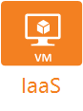

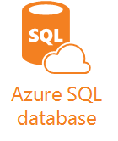





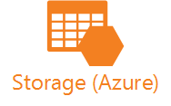




OUR AZURE EXPERIENCE
LIXAR has over seven years of Azure experience
Lixar is a Triple Gold Microsoft Partner, as well as a CSP Partner delivering Advanced Workloads in Azure including IoT, Machine Learning, and Cognitive Services.

Slide 69
WE LOVE TO HELP COMPANIES WHO WANT TO BE INNOVATIVE

